Slide 1
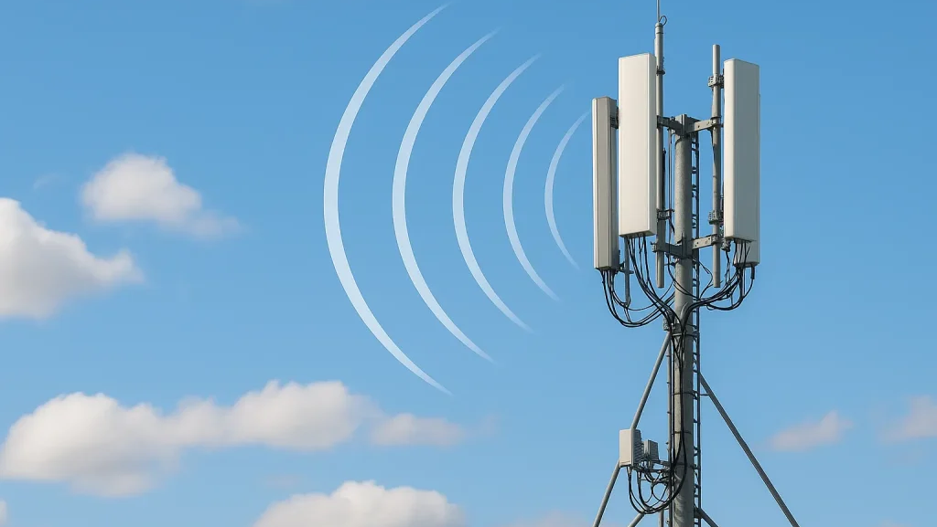
Part- I
Introduction to Wireless Cellular Networks
From Analog Voice to Intelligent 5G Networks
1G
2G
3G
4G
5G
Part I: Introduction
1 / 4
Notes:
Welcome to this presentation on the Evolution of Cellular Networks. In this introductory session, we will explore why cellular communication was invented, what problems it solves, and what driving forces have shaped its evolution from the first generation to the intelligent 5G networks we see today. Before cellular networks, communication was entirely tethered. People used wired telephones that required a physical connection to a landline. This meant you could only make or receive calls from specific locations, typically your home or office. The concept of mobility in communication was virtually nonexistent. The fundamental breakthrough of cellular technology was the idea of dividing geographic areas into "cells," each served by a base station or cell tower. This cellular concept, first proposed by Bell Labs engineers in the 1940s and implemented in the 1980s, allowed frequency reuse and made large-scale mobile telephony economically viable. As we trace the timeline from 1G in the 1980s through to 5G today, notice that each generation was not merely a speed upgrade. Each generation responded to fundamentally new demands: 1G solved basic mobile voice, 2G added digital clarity and texting, 3G brought the internet to our pockets, 4G enabled mobile broadband and streaming, and 5G is designed for an entirely new era of intelligent connected devices, from autonomous vehicles to smart cities. By the end of Part I, you should understand the key motivations behind cellular network evolution and appreciate how user demands and technological capabilities have always advanced together.

Slide 2
Contents
Introduction to Wireless Cellular Networks
Before Cellular Networks
Limitations of Pre-Cellular Networks
The Cellular Concept
Frequency Reuse
Basic Mobile Network Architecture
First Generation (1G) Cellular Networks
1G Network Architecture
Why Was 2G Needed?
Transition from Analog to Digital Communication (Introduction to 2G)
More Users
Beer Spectrum
Higher Capacity
Higher Speed
Better Experience
Part I
Notes:
This final slide of Part I summarizes the core objectives that have guided the evolution of cellular networks across all generations. Understanding these objectives helps us appreciate why each design decision was made and what the industry aims to achieve with ongoing research into 5G-Advanced and 6G. Let's examine the ten key parameters that cellular engineers continuously optimize: **Coverage:** From 1G to 5G, the goal has always been to extend network reach. Early cellular networks covered only major cities. Today, we expect coverage everywhere—rural areas, highways, underground trains, and even remote oceans via satellite integration. Each generation improves propagation characteristics and builds more cell towers. **Capacity:** As more users join and each user consumes more data, networks must handle higher traffic density. Techniques like cell splitting (dividing large cells into smaller ones), spectrum expansion, and advanced modulation have multiplied network capacity by millions of times since 1G. **Data Rate:** Perhaps the most visible metric—each generation delivers dramatically faster speeds. 1G's 2.4 kbps versus 5G's 20 Gbps represents an approximately 8-million-fold increase. This enables richer applications from text to video to immersive experiences. **Latency:** While early networks had latency of hundreds of milliseconds, 5G aims for under 1 millisecond. Low latency is critical for real-time applications like online gaming, virtual reality, remote surgery, and autonomous vehicle coordination where delays can be dangerous. **Reliability:** 5G targets 99.9999% reliability (six nines) for mission-critical applications. This means the network can fail for only about 30 seconds per year. Achieving this requires redundant infrastructure, intelligent routing, and self-healing network capabilities. **Security:** Each generation has introduced stronger encryption and authentication. 5G implements advanced security features including stronger encryption algorithms, subscriber privacy protection, and network slicing isolation to prevent cross-tenant attacks. **Energy Efficiency:** With billions of devices and millions of base stations, energy consumption matters both environmentally and economically. 5G is designed to use significantly less energy per bit transmitted, and supports features that allow IoT devices to operate for years on a single battery. **Quality of Service (QoS):** Modern networks must prioritize different traffic types appropriately—emergency calls get highest priority, video calls need consistent bandwidth, and IoT sensors can tolerate delays. Network slicing in 5G creates virtual networks optimized for specific services. **Mobility:** Supporting users moving at high speeds—from walking to cars to high-speed trains—is a fundamental cellular challenge. Each generation improves handover mechanisms that seamlessly transfer connections between base stations. **Spectral Efficiency:** Spectrum is limited and expensive. Each generation packs more bits per Hertz of spectrum through advanced techniques like MIMO (Multiple Input Multiple Output), beamforming, and higher-order modulation. The conceptual diagram shows the virtuous cycle: more users demand better spectrum usage, which enables higher capacity, which delivers higher speed, which creates better user experience—driving demand even further.

Slide 3
Before Cellular Networks: The Early Days of Mobile Communication
Mobile Telephone Service (MTS)
Introduced in 1946.
Designed mainly for vehicles (car telephones).
Used analogue radio communication.
Calls were connected manually by a telephone operator.
Only a small number of users could communicate simultaneously.
Improved Mobile Telephone Service (IMTS)
Introduced in 1964 with several improvements:
Automatic call setup (no manual operator).
More available radio channels.
Better coverage than MTS.
Improved voice quality.
Despite these improvements, IMTS still suffered from major limitations.
Year | System | Key Development
1946 | Mobile Telephone Service (MTS) | First public mobile telephone service
1964 | Improved Mobile Telephone Service (IMTS) | Automatic dialing and more channels
1980s | First Generation (1G) | Birth of cellular communication
More Users
Beer Spectrum
Higher Capacity
Higher Speed
Better Experience
If one transmitter could cover an entire city, why wasn't it enough?
Part I
Notes:
This final slide of Part I summarizes the core objectives that have guided the evolution of cellular networks across all generations. Understanding these objectives helps us appreciate why each design decision was made and what the industry aims to achieve with ongoing research into 5G-Advanced and 6G. Let's examine the ten key parameters that cellular engineers continuously optimize: **Coverage:** From 1G to 5G, the goal has always been to extend network reach. Early cellular networks covered only major cities. Today, we expect coverage everywhere—rural areas, highways, underground trains, and even remote oceans via satellite integration. Each generation improves propagation characteristics and builds more cell towers. **Capacity:** As more users join and each user consumes more data, networks must handle higher traffic density. Techniques like cell splitting (dividing large cells into smaller ones), spectrum expansion, and advanced modulation have multiplied network capacity by millions of times since 1G. **Data Rate:** Perhaps the most visible metric—each generation delivers dramatically faster speeds. 1G's 2.4 kbps versus 5G's 20 Gbps represents an approximately 8-million-fold increase. This enables richer applications from text to video to immersive experiences. **Latency:** While early networks had latency of hundreds of milliseconds, 5G aims for under 1 millisecond. Low latency is critical for real-time applications like online gaming, virtual reality, remote surgery, and autonomous vehicle coordination where delays can be dangerous. **Reliability:** 5G targets 99.9999% reliability (six nines) for mission-critical applications. This means the network can fail for only about 30 seconds per year. Achieving this requires redundant infrastructure, intelligent routing, and self-healing network capabilities. **Security:** Each generation has introduced stronger encryption and authentication. 5G implements advanced security features including stronger encryption algorithms, subscriber privacy protection, and network slicing isolation to prevent cross-tenant attacks. **Energy Efficiency:** With billions of devices and millions of base stations, energy consumption matters both environmentally and economically. 5G is designed to use significantly less energy per bit transmitted, and supports features that allow IoT devices to operate for years on a single battery. **Quality of Service (QoS):** Modern networks must prioritize different traffic types appropriately—emergency calls get highest priority, video calls need consistent bandwidth, and IoT sensors can tolerate delays. Network slicing in 5G creates virtual networks optimized for specific services. **Mobility:** Supporting users moving at high speeds—from walking to cars to high-speed trains—is a fundamental cellular challenge. Each generation improves handover mechanisms that seamlessly transfer connections between base stations. **Spectral Efficiency:** Spectrum is limited and expensive. Each generation packs more bits per Hertz of spectrum through advanced techniques like MIMO (Multiple Input Multiple Output), beamforming, and higher-order modulation. The conceptual diagram shows the virtuous cycle: more users demand better spectrum usage, which enables higher capacity, which delivers higher speed, which creates better user experience—driving demand even further.

Slide 4
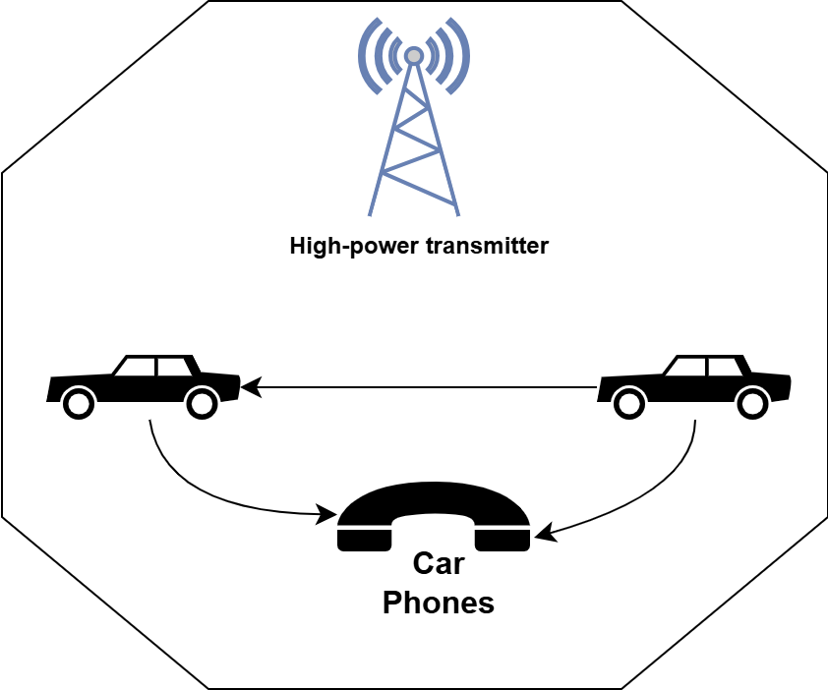
Why Did Pre-Cellular Networks Fail?
Problem | Impact
One high-power transmitter | Entire city depended on one station
Limited radio spectrum | Only a few radio channels available
Manual / Semi-automatic switching | Slow call setup
High transmit power | Large, bulky car phones
Analog communication | Poor voice quality and low security
A city has 500,000 people but only 25 radio channels. What will be its implications?
More Users
Beer Spectrum
Higher Capacity
Higher Speed
Better Experience
Instead of making one transmitter more powerful, what if we divided the city into many smaller coverage areas?
Part I
Notes:
This final slide of Part I summarizes the core objectives that have guided the evolution of cellular networks across all generations. Understanding these objectives helps us appreciate why each design decision was made and what the industry aims to achieve with ongoing research into 5G-Advanced and 6G. Let's examine the ten key parameters that cellular engineers continuously optimize: **Coverage:** From 1G to 5G, the goal has always been to extend network reach. Early cellular networks covered only major cities. Today, we expect coverage everywhere—rural areas, highways, underground trains, and even remote oceans via satellite integration. Each generation improves propagation characteristics and builds more cell towers. **Capacity:** As more users join and each user consumes more data, networks must handle higher traffic density. Techniques like cell splitting (dividing large cells into smaller ones), spectrum expansion, and advanced modulation have multiplied network capacity by millions of times since 1G. **Data Rate:** Perhaps the most visible metric—each generation delivers dramatically faster speeds. 1G's 2.4 kbps versus 5G's 20 Gbps represents an approximately 8-million-fold increase. This enables richer applications from text to video to immersive experiences. **Latency:** While early networks had latency of hundreds of milliseconds, 5G aims for under 1 millisecond. Low latency is critical for real-time applications like online gaming, virtual reality, remote surgery, and autonomous vehicle coordination where delays can be dangerous. **Reliability:** 5G targets 99.9999% reliability (six nines) for mission-critical applications. This means the network can fail for only about 30 seconds per year. Achieving this requires redundant infrastructure, intelligent routing, and self-healing network capabilities. **Security:** Each generation has introduced stronger encryption and authentication. 5G implements advanced security features including stronger encryption algorithms, subscriber privacy protection, and network slicing isolation to prevent cross-tenant attacks. **Energy Efficiency:** With billions of devices and millions of base stations, energy consumption matters both environmentally and economically. 5G is designed to use significantly less energy per bit transmitted, and supports features that allow IoT devices to operate for years on a single battery. **Quality of Service (QoS):** Modern networks must prioritize different traffic types appropriately—emergency calls get highest priority, video calls need consistent bandwidth, and IoT sensors can tolerate delays. Network slicing in 5G creates virtual networks optimized for specific services. **Mobility:** Supporting users moving at high speeds—from walking to cars to high-speed trains—is a fundamental cellular challenge. Each generation improves handover mechanisms that seamlessly transfer connections between base stations. **Spectral Efficiency:** Spectrum is limited and expensive. Each generation packs more bits per Hertz of spectrum through advanced techniques like MIMO (Multiple Input Multiple Output), beamforming, and higher-order modulation. The conceptual diagram shows the virtuous cycle: more users demand better spectrum usage, which enables higher capacity, which delivers higher speed, which creates better user experience—driving demand even further.

Slide 5
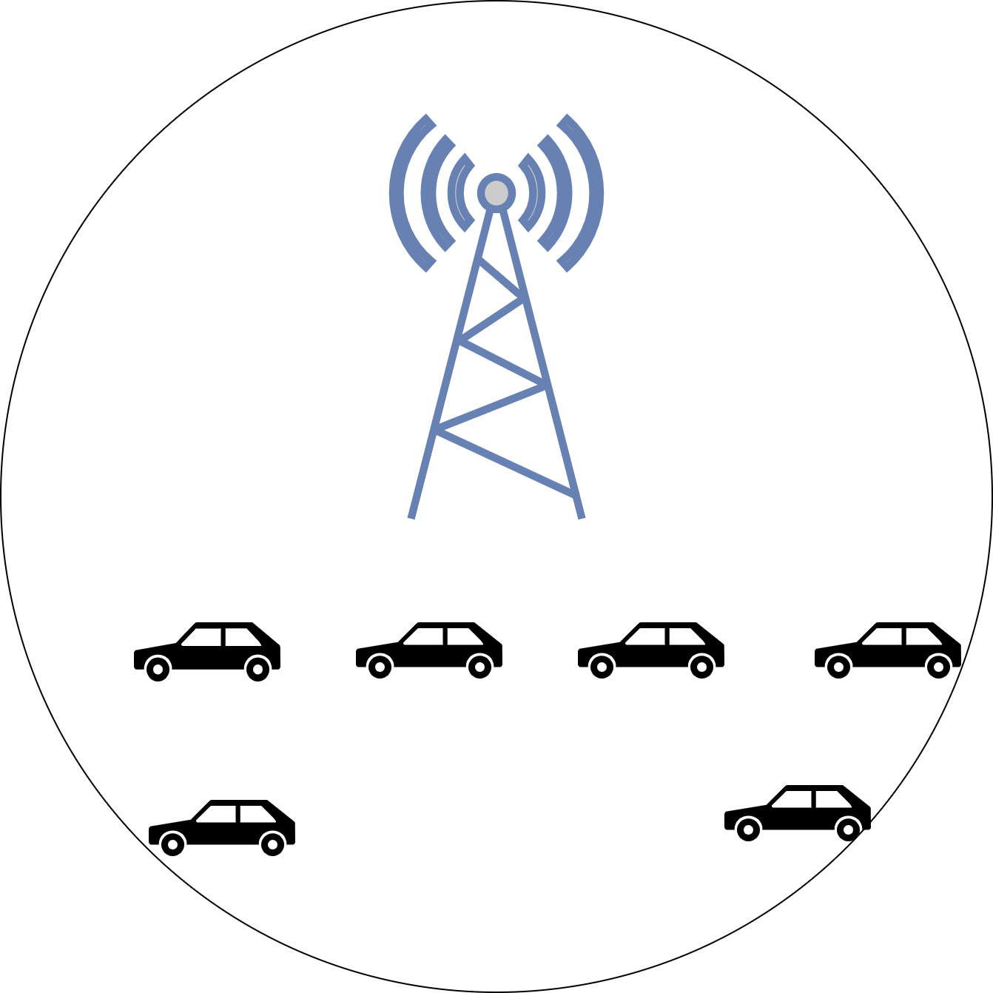
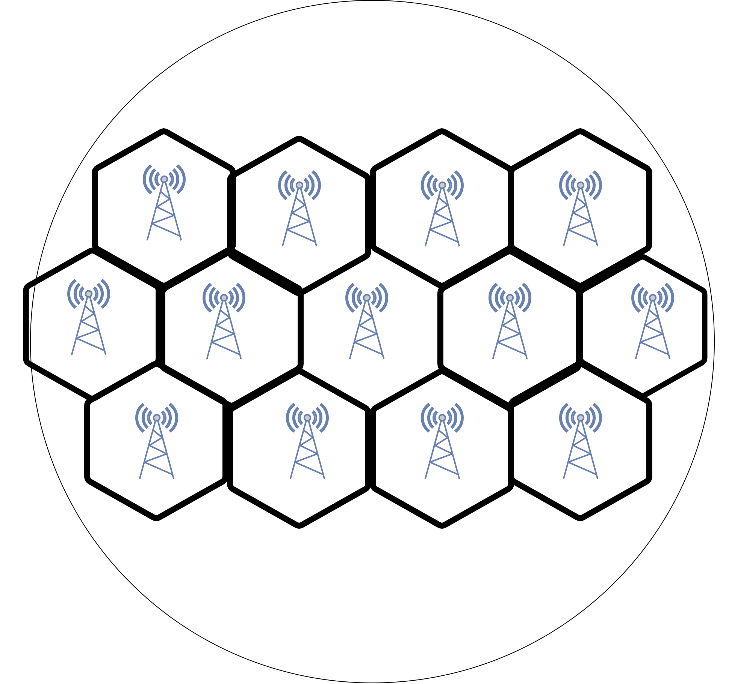
The Cellular Concept
More Users
The Solution
The service area is divided into smaller cells, each served by its own Base Station (BS).
The Problem
One base station cannot efficiently serve a
large number of users.
Higher Speed
Better Experience
What is a Cell?
A cell is a small geographical area served by a dedicated Base Station (BS).
Part I
Notes:
This final slide of Part I summarizes the core objectives that have guided the evolution of cellular networks across all generations. Understanding these objectives helps us appreciate why each design decision was made and what the industry aims to achieve with ongoing research into 5G-Advanced and 6G. Let's examine the ten key parameters that cellular engineers continuously optimize: **Coverage:** From 1G to 5G, the goal has always been to extend network reach. Early cellular networks covered only major cities. Today, we expect coverage everywhere—rural areas, highways, underground trains, and even remote oceans via satellite integration. Each generation improves propagation characteristics and builds more cell towers. **Capacity:** As more users join and each user consumes more data, networks must handle higher traffic density. Techniques like cell splitting (dividing large cells into smaller ones), spectrum expansion, and advanced modulation have multiplied network capacity by millions of times since 1G. **Data Rate:** Perhaps the most visible metric—each generation delivers dramatically faster speeds. 1G's 2.4 kbps versus 5G's 20 Gbps represents an approximately 8-million-fold increase. This enables richer applications from text to video to immersive experiences. **Latency:** While early networks had latency of hundreds of milliseconds, 5G aims for under 1 millisecond. Low latency is critical for real-time applications like online gaming, virtual reality, remote surgery, and autonomous vehicle coordination where delays can be dangerous. **Reliability:** 5G targets 99.9999% reliability (six nines) for mission-critical applications. This means the network can fail for only about 30 seconds per year. Achieving this requires redundant infrastructure, intelligent routing, and self-healing network capabilities. **Security:** Each generation has introduced stronger encryption and authentication. 5G implements advanced security features including stronger encryption algorithms, subscriber privacy protection, and network slicing isolation to prevent cross-tenant attacks. **Energy Efficiency:** With billions of devices and millions of base stations, energy consumption matters both environmentally and economically. 5G is designed to use significantly less energy per bit transmitted, and supports features that allow IoT devices to operate for years on a single battery. **Quality of Service (QoS):** Modern networks must prioritize different traffic types appropriately—emergency calls get highest priority, video calls need consistent bandwidth, and IoT sensors can tolerate delays. Network slicing in 5G creates virtual networks optimized for specific services. **Mobility:** Supporting users moving at high speeds—from walking to cars to high-speed trains—is a fundamental cellular challenge. Each generation improves handover mechanisms that seamlessly transfer connections between base stations. **Spectral Efficiency:** Spectrum is limited and expensive. Each generation packs more bits per Hertz of spectrum through advanced techniques like MIMO (Multiple Input Multiple Output), beamforming, and higher-order modulation. The conceptual diagram shows the virtuous cycle: more users demand better spectrum usage, which enables higher capacity, which delivers higher speed, which creates better user experience—driving demand even further.

Slide 6
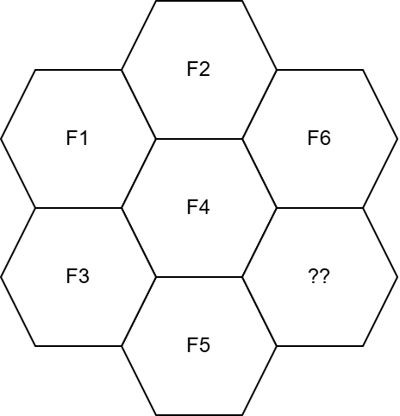
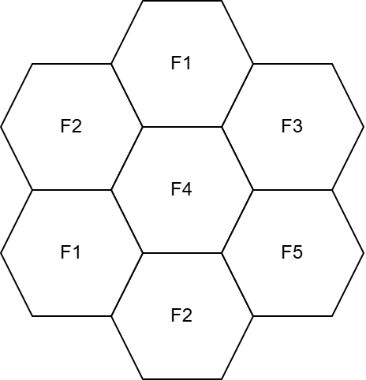
Frequency Reuse: The Foundation of Cellular Networks
Suppose every cell is assigned a unique set of frequencies.
Can we keep adding new cells forever?
More Users
Beer Spectrum
Higher Capacity
Higher Speed
Better Experience
Frequency reuse is the technique of using the same radio frequency channels in different cells that are sufficiently far apart to avoid interference.
Part I
Notes:
This final slide of Part I summarizes the core objectives that have guided the evolution of cellular networks across all generations. Understanding these objectives helps us appreciate why each design decision was made and what the industry aims to achieve with ongoing research into 5G-Advanced and 6G. Let's examine the ten key parameters that cellular engineers continuously optimize: **Coverage:** From 1G to 5G, the goal has always been to extend network reach. Early cellular networks covered only major cities. Today, we expect coverage everywhere—rural areas, highways, underground trains, and even remote oceans via satellite integration. Each generation improves propagation characteristics and builds more cell towers. **Capacity:** As more users join and each user consumes more data, networks must handle higher traffic density. Techniques like cell splitting (dividing large cells into smaller ones), spectrum expansion, and advanced modulation have multiplied network capacity by millions of times since 1G. **Data Rate:** Perhaps the most visible metric—each generation delivers dramatically faster speeds. 1G's 2.4 kbps versus 5G's 20 Gbps represents an approximately 8-million-fold increase. This enables richer applications from text to video to immersive experiences. **Latency:** While early networks had latency of hundreds of milliseconds, 5G aims for under 1 millisecond. Low latency is critical for real-time applications like online gaming, virtual reality, remote surgery, and autonomous vehicle coordination where delays can be dangerous. **Reliability:** 5G targets 99.9999% reliability (six nines) for mission-critical applications. This means the network can fail for only about 30 seconds per year. Achieving this requires redundant infrastructure, intelligent routing, and self-healing network capabilities. **Security:** Each generation has introduced stronger encryption and authentication. 5G implements advanced security features including stronger encryption algorithms, subscriber privacy protection, and network slicing isolation to prevent cross-tenant attacks. **Energy Efficiency:** With billions of devices and millions of base stations, energy consumption matters both environmentally and economically. 5G is designed to use significantly less energy per bit transmitted, and supports features that allow IoT devices to operate for years on a single battery. **Quality of Service (QoS):** Modern networks must prioritize different traffic types appropriately—emergency calls get highest priority, video calls need consistent bandwidth, and IoT sensors can tolerate delays. Network slicing in 5G creates virtual networks optimized for specific services. **Mobility:** Supporting users moving at high speeds—from walking to cars to high-speed trains—is a fundamental cellular challenge. Each generation improves handover mechanisms that seamlessly transfer connections between base stations. **Spectral Efficiency:** Spectrum is limited and expensive. Each generation packs more bits per Hertz of spectrum through advanced techniques like MIMO (Multiple Input Multiple Output), beamforming, and higher-order modulation. The conceptual diagram shows the virtuous cycle: more users demand better spectrum usage, which enables higher capacity, which delivers higher speed, which creates better user experience—driving demand even further.

Slide 7
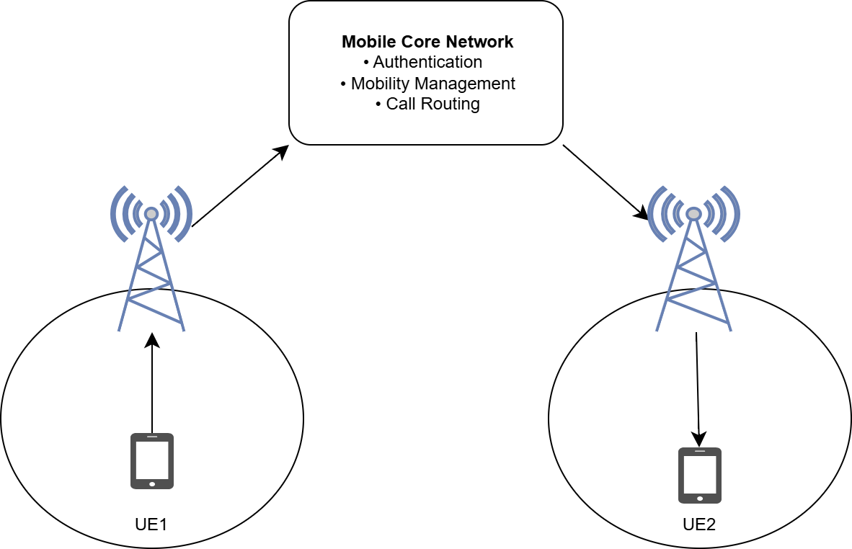
How Does a Mobile Network Work?
The three main components if of mobile communication networks are –
Radio Access Networks(RANs):The RAN provides the wireless interface between the user device (User Equipment or UE) and the mobile network
Mobile Transport and Backhaul: The transport and backhaul network connects the RAN to the mobile core. It carries user data, signaling traffic, and synchronization information using high-speed fiber, microwave, or Ethernet links, ensuring reliable and low-latency communication between different network elements.
Mobile core:The mobile core is the central intelligence of the network. It performs functions such as user authentication, mobility management, session establishment, policy enforcement, billing, and routing of voice and data traffic to external networks such as the Internet or other mobile networks.
More Users
Beer Spectrum
Higher Capacity
Higher Speed
Better Experience
This basic architecture has remained the foundation of mobile networks. Although the technologies have evolved from 1G to 5G, every generation still contains these essential functional blocks
Part I
Notes:
This final slide of Part I summarizes the core objectives that have guided the evolution of cellular networks across all generations. Understanding these objectives helps us appreciate why each design decision was made and what the industry aims to achieve with ongoing research into 5G-Advanced and 6G. Let's examine the ten key parameters that cellular engineers continuously optimize: **Coverage:** From 1G to 5G, the goal has always been to extend network reach. Early cellular networks covered only major cities. Today, we expect coverage everywhere—rural areas, highways, underground trains, and even remote oceans via satellite integration. Each generation improves propagation characteristics and builds more cell towers. **Capacity:** As more users join and each user consumes more data, networks must handle higher traffic density. Techniques like cell splitting (dividing large cells into smaller ones), spectrum expansion, and advanced modulation have multiplied network capacity by millions of times since 1G. **Data Rate:** Perhaps the most visible metric—each generation delivers dramatically faster speeds. 1G's 2.4 kbps versus 5G's 20 Gbps represents an approximately 8-million-fold increase. This enables richer applications from text to video to immersive experiences. **Latency:** While early networks had latency of hundreds of milliseconds, 5G aims for under 1 millisecond. Low latency is critical for real-time applications like online gaming, virtual reality, remote surgery, and autonomous vehicle coordination where delays can be dangerous. **Reliability:** 5G targets 99.9999% reliability (six nines) for mission-critical applications. This means the network can fail for only about 30 seconds per year. Achieving this requires redundant infrastructure, intelligent routing, and self-healing network capabilities. **Security:** Each generation has introduced stronger encryption and authentication. 5G implements advanced security features including stronger encryption algorithms, subscriber privacy protection, and network slicing isolation to prevent cross-tenant attacks. **Energy Efficiency:** With billions of devices and millions of base stations, energy consumption matters both environmentally and economically. 5G is designed to use significantly less energy per bit transmitted, and supports features that allow IoT devices to operate for years on a single battery. **Quality of Service (QoS):** Modern networks must prioritize different traffic types appropriately—emergency calls get highest priority, video calls need consistent bandwidth, and IoT sensors can tolerate delays. Network slicing in 5G creates virtual networks optimized for specific services. **Mobility:** Supporting users moving at high speeds—from walking to cars to high-speed trains—is a fundamental cellular challenge. Each generation improves handover mechanisms that seamlessly transfer connections between base stations. **Spectral Efficiency:** Spectrum is limited and expensive. Each generation packs more bits per Hertz of spectrum through advanced techniques like MIMO (Multiple Input Multiple Output), beamforming, and higher-order modulation. The conceptual diagram shows the virtuous cycle: more users demand better spectrum usage, which enables higher capacity, which delivers higher speed, which creates better user experience—driving demand even further.

Slide 8
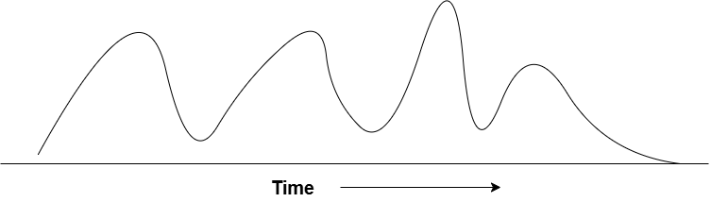
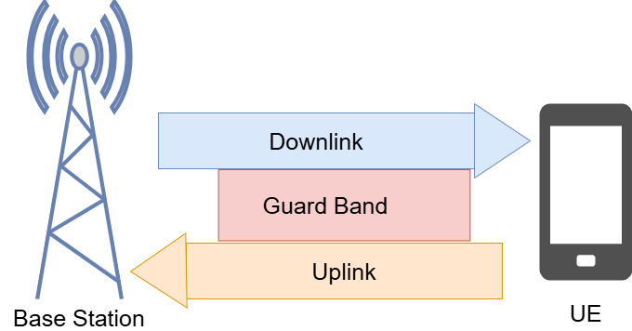
First Generation (1G): The Birth of Cellular Mobile Networks
First Generation (1G)
Introduced in the early 1980s.
First commercially deployed cellular mobile network.
Used analogue voice communication.
Based on Frequency Division Multiple Access (FDMA).
Designed primarily for voice calls.
For example-
1850-1910 MHz for Uplink
20 MHz Guard band
1930-1990 MHz for downlink
Region | Standard
USA | Advanced Mobile Phone System
Europe | Total Access Communication System
Nordic Countries (Sweden, Norway, Finland, Denmark) | Nordic Mobile Telephone
More Users
Higher Capacity
Higher Speed
Better Experience
Introduced the cellular architecture into commercial mobile communication.
Part I
Notes:
This final slide of Part I summarizes the core objectives that have guided the evolution of cellular networks across all generations. Understanding these objectives helps us appreciate why each design decision was made and what the industry aims to achieve with ongoing research into 5G-Advanced and 6G. Let's examine the ten key parameters that cellular engineers continuously optimize: **Coverage:** From 1G to 5G, the goal has always been to extend network reach. Early cellular networks covered only major cities. Today, we expect coverage everywhere—rural areas, highways, underground trains, and even remote oceans via satellite integration. Each generation improves propagation characteristics and builds more cell towers. **Capacity:** As more users join and each user consumes more data, networks must handle higher traffic density. Techniques like cell splitting (dividing large cells into smaller ones), spectrum expansion, and advanced modulation have multiplied network capacity by millions of times since 1G. **Data Rate:** Perhaps the most visible metric—each generation delivers dramatically faster speeds. 1G's 2.4 kbps versus 5G's 20 Gbps represents an approximately 8-million-fold increase. This enables richer applications from text to video to immersive experiences. **Latency:** While early networks had latency of hundreds of milliseconds, 5G aims for under 1 millisecond. Low latency is critical for real-time applications like online gaming, virtual reality, remote surgery, and autonomous vehicle coordination where delays can be dangerous. **Reliability:** 5G targets 99.9999% reliability (six nines) for mission-critical applications. This means the network can fail for only about 30 seconds per year. Achieving this requires redundant infrastructure, intelligent routing, and self-healing network capabilities. **Security:** Each generation has introduced stronger encryption and authentication. 5G implements advanced security features including stronger encryption algorithms, subscriber privacy protection, and network slicing isolation to prevent cross-tenant attacks. **Energy Efficiency:** With billions of devices and millions of base stations, energy consumption matters both environmentally and economically. 5G is designed to use significantly less energy per bit transmitted, and supports features that allow IoT devices to operate for years on a single battery. **Quality of Service (QoS):** Modern networks must prioritize different traffic types appropriately—emergency calls get highest priority, video calls need consistent bandwidth, and IoT sensors can tolerate delays. Network slicing in 5G creates virtual networks optimized for specific services. **Mobility:** Supporting users moving at high speeds—from walking to cars to high-speed trains—is a fundamental cellular challenge. Each generation improves handover mechanisms that seamlessly transfer connections between base stations. **Spectral Efficiency:** Spectrum is limited and expensive. Each generation packs more bits per Hertz of spectrum through advanced techniques like MIMO (Multiple Input Multiple Output), beamforming, and higher-order modulation. The conceptual diagram shows the virtuous cycle: more users demand better spectrum usage, which enables higher capacity, which delivers higher speed, which creates better user experience—driving demand even further.

Slide 9
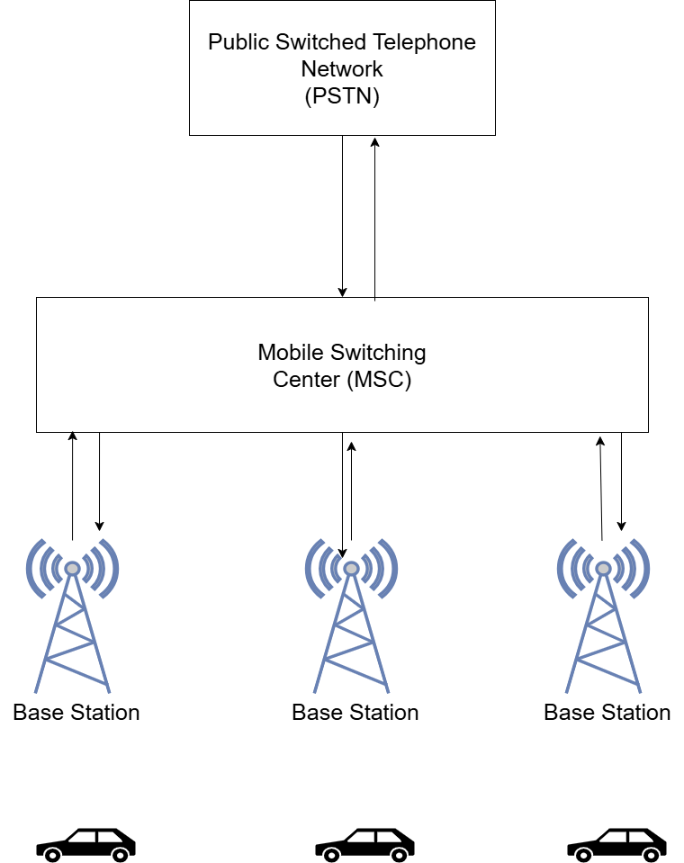
1G Cellular Network Architecture
📱 Mobile User / User Equipment (UE)
The User Equipment (UE), commonly referred to as the mobile phone or handset, is the device used by the subscriber to access the mobile network. It converts the user's voice or data into radio signals for wireless transmission and receives radio signals from the network for communication.
📡 Base Station (BS)
The Base Station (BS) is the radio access point that provides wireless coverage for a specific geographical area known as a cell. It establishes and maintains the radio link with all mobile users within its coverage area by transmitting and receiving radio signals. In addition, the Base Station allocates radio channels, manages wireless resources, and forwards user traffic to the Mobile Switching Center. It acts as the bridge between the wireless users and the wired backbone of the mobile network, enabling seamless communication between mobile devices and the core network.
☎ Mobile Switching Center (MSC)
The Mobile Switching Center (MSC) is the central control unit and the brain of the 1G cellular network. It is responsible for managing the entire communication process by establishing, routing, and terminating telephone calls. The MSC coordinates communication between multiple Base Stations, performs handoff operations when a user moves from one cell to another, and routes calls to other MSCs or to the Public Switched Telephone Network (PSTN) for communication with landline users. By maintaining information about ongoing calls and controlling network resources, the MSC ensures reliable and uninterrupted mobile communication.
☎ Public Switched Telephone Network (PSTN)
The Public Switched Telephone Network (PSTN) is the traditional global circuit-switched telephone network that connects landline telephones and external communication systems. In a 1G mobile network, the MSC interfaces with the PSTN to route calls between mobile users and fixed-line subscribers. This allows a mobile user to communicate not only with other mobile users but also with telephones anywhere in the world that are connected through the conventional telephone network.
More Users
Beer Spectrum
Higher Capacity
Higher Speed
Better Experience
In 1G, the MSC performed most of the network management functions. As mobile networks grew and roaming became common, new database elements were introduced to efficiently manage subscriber information
Part I
Notes:
This final slide of Part I summarizes the core objectives that have guided the evolution of cellular networks across all generations. Understanding these objectives helps us appreciate why each design decision was made and what the industry aims to achieve with ongoing research into 5G-Advanced and 6G. Let's examine the ten key parameters that cellular engineers continuously optimize: **Coverage:** From 1G to 5G, the goal has always been to extend network reach. Early cellular networks covered only major cities. Today, we expect coverage everywhere—rural areas, highways, underground trains, and even remote oceans via satellite integration. Each generation improves propagation characteristics and builds more cell towers. **Capacity:** As more users join and each user consumes more data, networks must handle higher traffic density. Techniques like cell splitting (dividing large cells into smaller ones), spectrum expansion, and advanced modulation have multiplied network capacity by millions of times since 1G. **Data Rate:** Perhaps the most visible metric—each generation delivers dramatically faster speeds. 1G's 2.4 kbps versus 5G's 20 Gbps represents an approximately 8-million-fold increase. This enables richer applications from text to video to immersive experiences. **Latency:** While early networks had latency of hundreds of milliseconds, 5G aims for under 1 millisecond. Low latency is critical for real-time applications like online gaming, virtual reality, remote surgery, and autonomous vehicle coordination where delays can be dangerous. **Reliability:** 5G targets 99.9999% reliability (six nines) for mission-critical applications. This means the network can fail for only about 30 seconds per year. Achieving this requires redundant infrastructure, intelligent routing, and self-healing network capabilities. **Security:** Each generation has introduced stronger encryption and authentication. 5G implements advanced security features including stronger encryption algorithms, subscriber privacy protection, and network slicing isolation to prevent cross-tenant attacks. **Energy Efficiency:** With billions of devices and millions of base stations, energy consumption matters both environmentally and economically. 5G is designed to use significantly less energy per bit transmitted, and supports features that allow IoT devices to operate for years on a single battery. **Quality of Service (QoS):** Modern networks must prioritize different traffic types appropriately—emergency calls get highest priority, video calls need consistent bandwidth, and IoT sensors can tolerate delays. Network slicing in 5G creates virtual networks optimized for specific services. **Mobility:** Supporting users moving at high speeds—from walking to cars to high-speed trains—is a fundamental cellular challenge. Each generation improves handover mechanisms that seamlessly transfer connections between base stations. **Spectral Efficiency:** Spectrum is limited and expensive. Each generation packs more bits per Hertz of spectrum through advanced techniques like MIMO (Multiple Input Multiple Output), beamforming, and higher-order modulation. The conceptual diagram shows the virtuous cycle: more users demand better spectrum usage, which enables higher capacity, which delivers higher speed, which creates better user experience—driving demand even further.

Slide 10
Why Was 2G Needed?
What 1G Introduced (Strengths) | Limitations of 1G (Why 2G Was Needed)
Cellular Architecture – Divided large service areas into small cells, significantly increasing network capacity. | Analog Communication – Voice was transmitted using analog signals, making communication susceptible to noise and interference.
Frequency Reuse – Enabled efficient utilization of the limited radio spectrum by reusing frequencies in non-adjacent cells. | Poor Voice Quality – Analog transmission often resulted in static noise, signal degradation, and dropped calls.
Mobility Support – Users could move between cells while maintaining an ongoing call through handoff mechanisms. | No Security or Privacy – Calls were not encrypted and could be intercepted using radio scanners.
Commercial Mobile Telephony – Made large-scale public mobile communication commercially viable for the first time. | Voice-Only Service – Supported only voice calls; services such as SMS, email, or Internet access were unavailable.
Improved Coverage – Multiple base stations provided better geographical coverage than earlier pre-cellular systems. | Limited Capacity – Although much better than MTS/IMTS, the analog system still had limited user capacity due to inefficient spectrum utilization.
Foundation for Future Networks – Established the fundamental architecture (cell, base station, switching center) that continues to exist in modern mobile networks. | Large and Power-Hungry Devices – Early mobile phones were bulky, consumed significant battery power, and were expensive to own.
More Users
Beer Spectrum
Higher Capacity
Higher Speed
Better Experience
How can we improve mobile communication without changing the entire cellular architecture?
Part I
Notes:
This final slide of Part I summarizes the core objectives that have guided the evolution of cellular networks across all generations. Understanding these objectives helps us appreciate why each design decision was made and what the industry aims to achieve with ongoing research into 5G-Advanced and 6G. Let's examine the ten key parameters that cellular engineers continuously optimize: **Coverage:** From 1G to 5G, the goal has always been to extend network reach. Early cellular networks covered only major cities. Today, we expect coverage everywhere—rural areas, highways, underground trains, and even remote oceans via satellite integration. Each generation improves propagation characteristics and builds more cell towers. **Capacity:** As more users join and each user consumes more data, networks must handle higher traffic density. Techniques like cell splitting (dividing large cells into smaller ones), spectrum expansion, and advanced modulation have multiplied network capacity by millions of times since 1G. **Data Rate:** Perhaps the most visible metric—each generation delivers dramatically faster speeds. 1G's 2.4 kbps versus 5G's 20 Gbps represents an approximately 8-million-fold increase. This enables richer applications from text to video to immersive experiences. **Latency:** While early networks had latency of hundreds of milliseconds, 5G aims for under 1 millisecond. Low latency is critical for real-time applications like online gaming, virtual reality, remote surgery, and autonomous vehicle coordination where delays can be dangerous. **Reliability:** 5G targets 99.9999% reliability (six nines) for mission-critical applications. This means the network can fail for only about 30 seconds per year. Achieving this requires redundant infrastructure, intelligent routing, and self-healing network capabilities. **Security:** Each generation has introduced stronger encryption and authentication. 5G implements advanced security features including stronger encryption algorithms, subscriber privacy protection, and network slicing isolation to prevent cross-tenant attacks. **Energy Efficiency:** With billions of devices and millions of base stations, energy consumption matters both environmentally and economically. 5G is designed to use significantly less energy per bit transmitted, and supports features that allow IoT devices to operate for years on a single battery. **Quality of Service (QoS):** Modern networks must prioritize different traffic types appropriately—emergency calls get highest priority, video calls need consistent bandwidth, and IoT sensors can tolerate delays. Network slicing in 5G creates virtual networks optimized for specific services. **Mobility:** Supporting users moving at high speeds—from walking to cars to high-speed trains—is a fundamental cellular challenge. Each generation improves handover mechanisms that seamlessly transfer connections between base stations. **Spectral Efficiency:** Spectrum is limited and expensive. Each generation packs more bits per Hertz of spectrum through advanced techniques like MIMO (Multiple Input Multiple Output), beamforming, and higher-order modulation. The conceptual diagram shows the virtuous cycle: more users demand better spectrum usage, which enables higher capacity, which delivers higher speed, which creates better user experience—driving demand even further.

Slide 11
Transition from 1G to 2G
During the late 1980s,
Mobile phone subscribers increased rapidly.
Networks required higher capacity.
Users demanded better voice quality.
Privacy and security became essential.
New digital services such as SMS were emerging.
These requirements could not be satisfied by analog 1G networks.
Therefore,
The industry transitioned from Analog Communication to Digital Communication(101010101100101...).
Also 2G introduced us to Global System for Mobile Communications(GSM)
Moe Users
Better Spectrum
Higher Speed
Better Experience
What new technologies were introduced to build this digital mobile network?
Part I
Notes:
This final slide of Part I summarizes the core objectives that have guided the evolution of cellular networks across all generations. Understanding these objectives helps us appreciate why each design decision was made and what the industry aims to achieve with ongoing research into 5G-Advanced and 6G. Let's examine the ten key parameters that cellular engineers continuously optimize: **Coverage:** From 1G to 5G, the goal has always been to extend network reach. Early cellular networks covered only major cities. Today, we expect coverage everywhere—rural areas, highways, underground trains, and even remote oceans via satellite integration. Each generation improves propagation characteristics and builds more cell towers. **Capacity:** As more users join and each user consumes more data, networks must handle higher traffic density. Techniques like cell splitting (dividing large cells into smaller ones), spectrum expansion, and advanced modulation have multiplied network capacity by millions of times since 1G. **Data Rate:** Perhaps the most visible metric—each generation delivers dramatically faster speeds. 1G's 2.4 kbps versus 5G's 20 Gbps represents an approximately 8-million-fold increase. This enables richer applications from text to video to immersive experiences. **Latency:** While early networks had latency of hundreds of milliseconds, 5G aims for under 1 millisecond. Low latency is critical for real-time applications like online gaming, virtual reality, remote surgery, and autonomous vehicle coordination where delays can be dangerous. **Reliability:** 5G targets 99.9999% reliability (six nines) for mission-critical applications. This means the network can fail for only about 30 seconds per year. Achieving this requires redundant infrastructure, intelligent routing, and self-healing network capabilities. **Security:** Each generation has introduced stronger encryption and authentication. 5G implements advanced security features including stronger encryption algorithms, subscriber privacy protection, and network slicing isolation to prevent cross-tenant attacks. **Energy Efficiency:** With billions of devices and millions of base stations, energy consumption matters both environmentally and economically. 5G is designed to use significantly less energy per bit transmitted, and supports features that allow IoT devices to operate for years on a single battery. **Quality of Service (QoS):** Modern networks must prioritize different traffic types appropriately—emergency calls get highest priority, video calls need consistent bandwidth, and IoT sensors can tolerate delays. Network slicing in 5G creates virtual networks optimized for specific services. **Mobility:** Supporting users moving at high speeds—from walking to cars to high-speed trains—is a fundamental cellular challenge. Each generation improves handover mechanisms that seamlessly transfer connections between base stations. **Spectral Efficiency:** Spectrum is limited and expensive. Each generation packs more bits per Hertz of spectrum through advanced techniques like MIMO (Multiple Input Multiple Output), beamforming, and higher-order modulation. The conceptual diagram shows the virtuous cycle: more users demand better spectrum usage, which enables higher capacity, which delivers higher speed, which creates better user experience—driving demand even further.

Slide 12
Thank You…
Any Questions?
More Users
Beer Spectrum
Higher Capacity
Higher Speed
Better Experience
Part I
Notes:
This final slide of Part I summarizes the core objectives that have guided the evolution of cellular networks across all generations. Understanding these objectives helps us appreciate why each design decision was made and what the industry aims to achieve with ongoing research into 5G-Advanced and 6G. Let's examine the ten key parameters that cellular engineers continuously optimize: **Coverage:** From 1G to 5G, the goal has always been to extend network reach. Early cellular networks covered only major cities. Today, we expect coverage everywhere—rural areas, highways, underground trains, and even remote oceans via satellite integration. Each generation improves propagation characteristics and builds more cell towers. **Capacity:** As more users join and each user consumes more data, networks must handle higher traffic density. Techniques like cell splitting (dividing large cells into smaller ones), spectrum expansion, and advanced modulation have multiplied network capacity by millions of times since 1G. **Data Rate:** Perhaps the most visible metric—each generation delivers dramatically faster speeds. 1G's 2.4 kbps versus 5G's 20 Gbps represents an approximately 8-million-fold increase. This enables richer applications from text to video to immersive experiences. **Latency:** While early networks had latency of hundreds of milliseconds, 5G aims for under 1 millisecond. Low latency is critical for real-time applications like online gaming, virtual reality, remote surgery, and autonomous vehicle coordination where delays can be dangerous. **Reliability:** 5G targets 99.9999% reliability (six nines) for mission-critical applications. This means the network can fail for only about 30 seconds per year. Achieving this requires redundant infrastructure, intelligent routing, and self-healing network capabilities. **Security:** Each generation has introduced stronger encryption and authentication. 5G implements advanced security features including stronger encryption algorithms, subscriber privacy protection, and network slicing isolation to prevent cross-tenant attacks. **Energy Efficiency:** With billions of devices and millions of base stations, energy consumption matters both environmentally and economically. 5G is designed to use significantly less energy per bit transmitted, and supports features that allow IoT devices to operate for years on a single battery. **Quality of Service (QoS):** Modern networks must prioritize different traffic types appropriately—emergency calls get highest priority, video calls need consistent bandwidth, and IoT sensors can tolerate delays. Network slicing in 5G creates virtual networks optimized for specific services. **Mobility:** Supporting users moving at high speeds—from walking to cars to high-speed trains—is a fundamental cellular challenge. Each generation improves handover mechanisms that seamlessly transfer connections between base stations. **Spectral Efficiency:** Spectrum is limited and expensive. Each generation packs more bits per Hertz of spectrum through advanced techniques like MIMO (Multiple Input Multiple Output), beamforming, and higher-order modulation. The conceptual diagram shows the virtuous cycle: more users demand better spectrum usage, which enables higher capacity, which delivers higher speed, which creates better user experience—driving demand even further.

